Slide 1
Risk Perception
Denis O’Hora, Victoria Hogan, Martina Kelly
NUI Galway
Notes:
"You know what I mean": The Cost of Miscommunication
Denis O’Hora, NUI Galway
Communication breakdown is a common occurrence and, in most circumstances, a mild frustration that is easily dealt with. In high-risk environments, however, communication breakdown can have significant negative consequences. This presentation will focus on role of ambiguous language in such breakdowns and provide suggestions for leaders to enhance their communication.

Slide 2
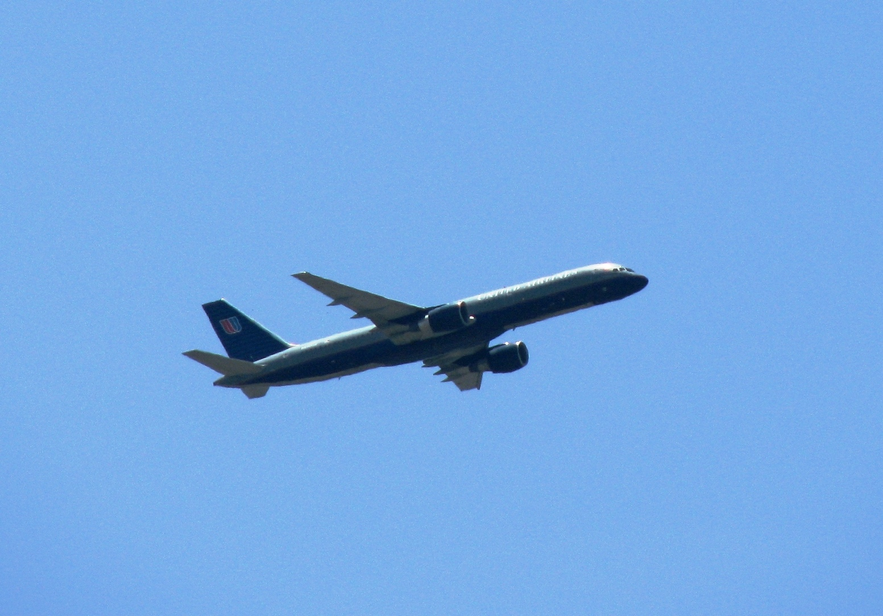
How did you get here today?
Fly or Drive?
Which is safer?
Which seems safer?
Notes:
Any links to previous talk?
I’m conscious that I’m speaking to an audience of expert risk assessors - for each of these risks you could give me a ‘back of the envelope’ assessment based on the strongest predictors/risk factors
You are experts in Objective Risk

Slide 3
How did you get here today?
8 deaths in Ireland since 2003
Which is safer?
Nearly 1500 deaths in Ireland
since 2003
Which seems safer?
Notes:
Any links to previous talk?
I’m conscious that I’m speaking to an audience of expert risk assessors - for each of these risks you could give me a ‘back of the envelope’ assessment based on the strongest predictors/risk factors
You are experts in Objective Risk

Slide 4
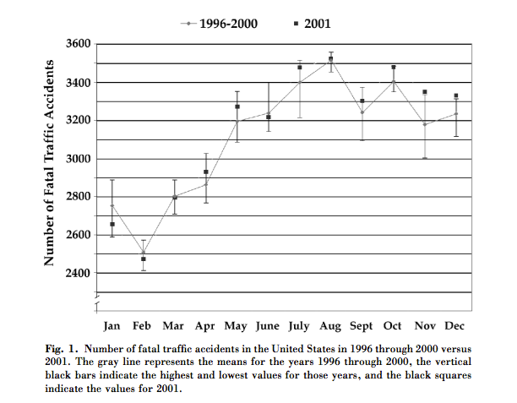
Subjective Risks
After 9/11, more Americans chose to drive instead of fly resulting in 350 extra car crashes
Notes:
Any links to previous talk?
I’m conscious that I’m speaking to an audience of expert risk assessors - for each of these risks you could give me a ‘back of the envelope’ assessment based on the strongest predictors/risk factors
You are experts in Objective Risk

Slide 5
Risk Perception
Between objective risk and behaviour lies subjective risk perception
When and How is subjective risk different from objective risk?
Notes:
As experts in Objective Risk, you are more likely to take objective risk assessments more seriously, but even you will have subjective risk perceptions that do not align with these objective assessments

Slide 6
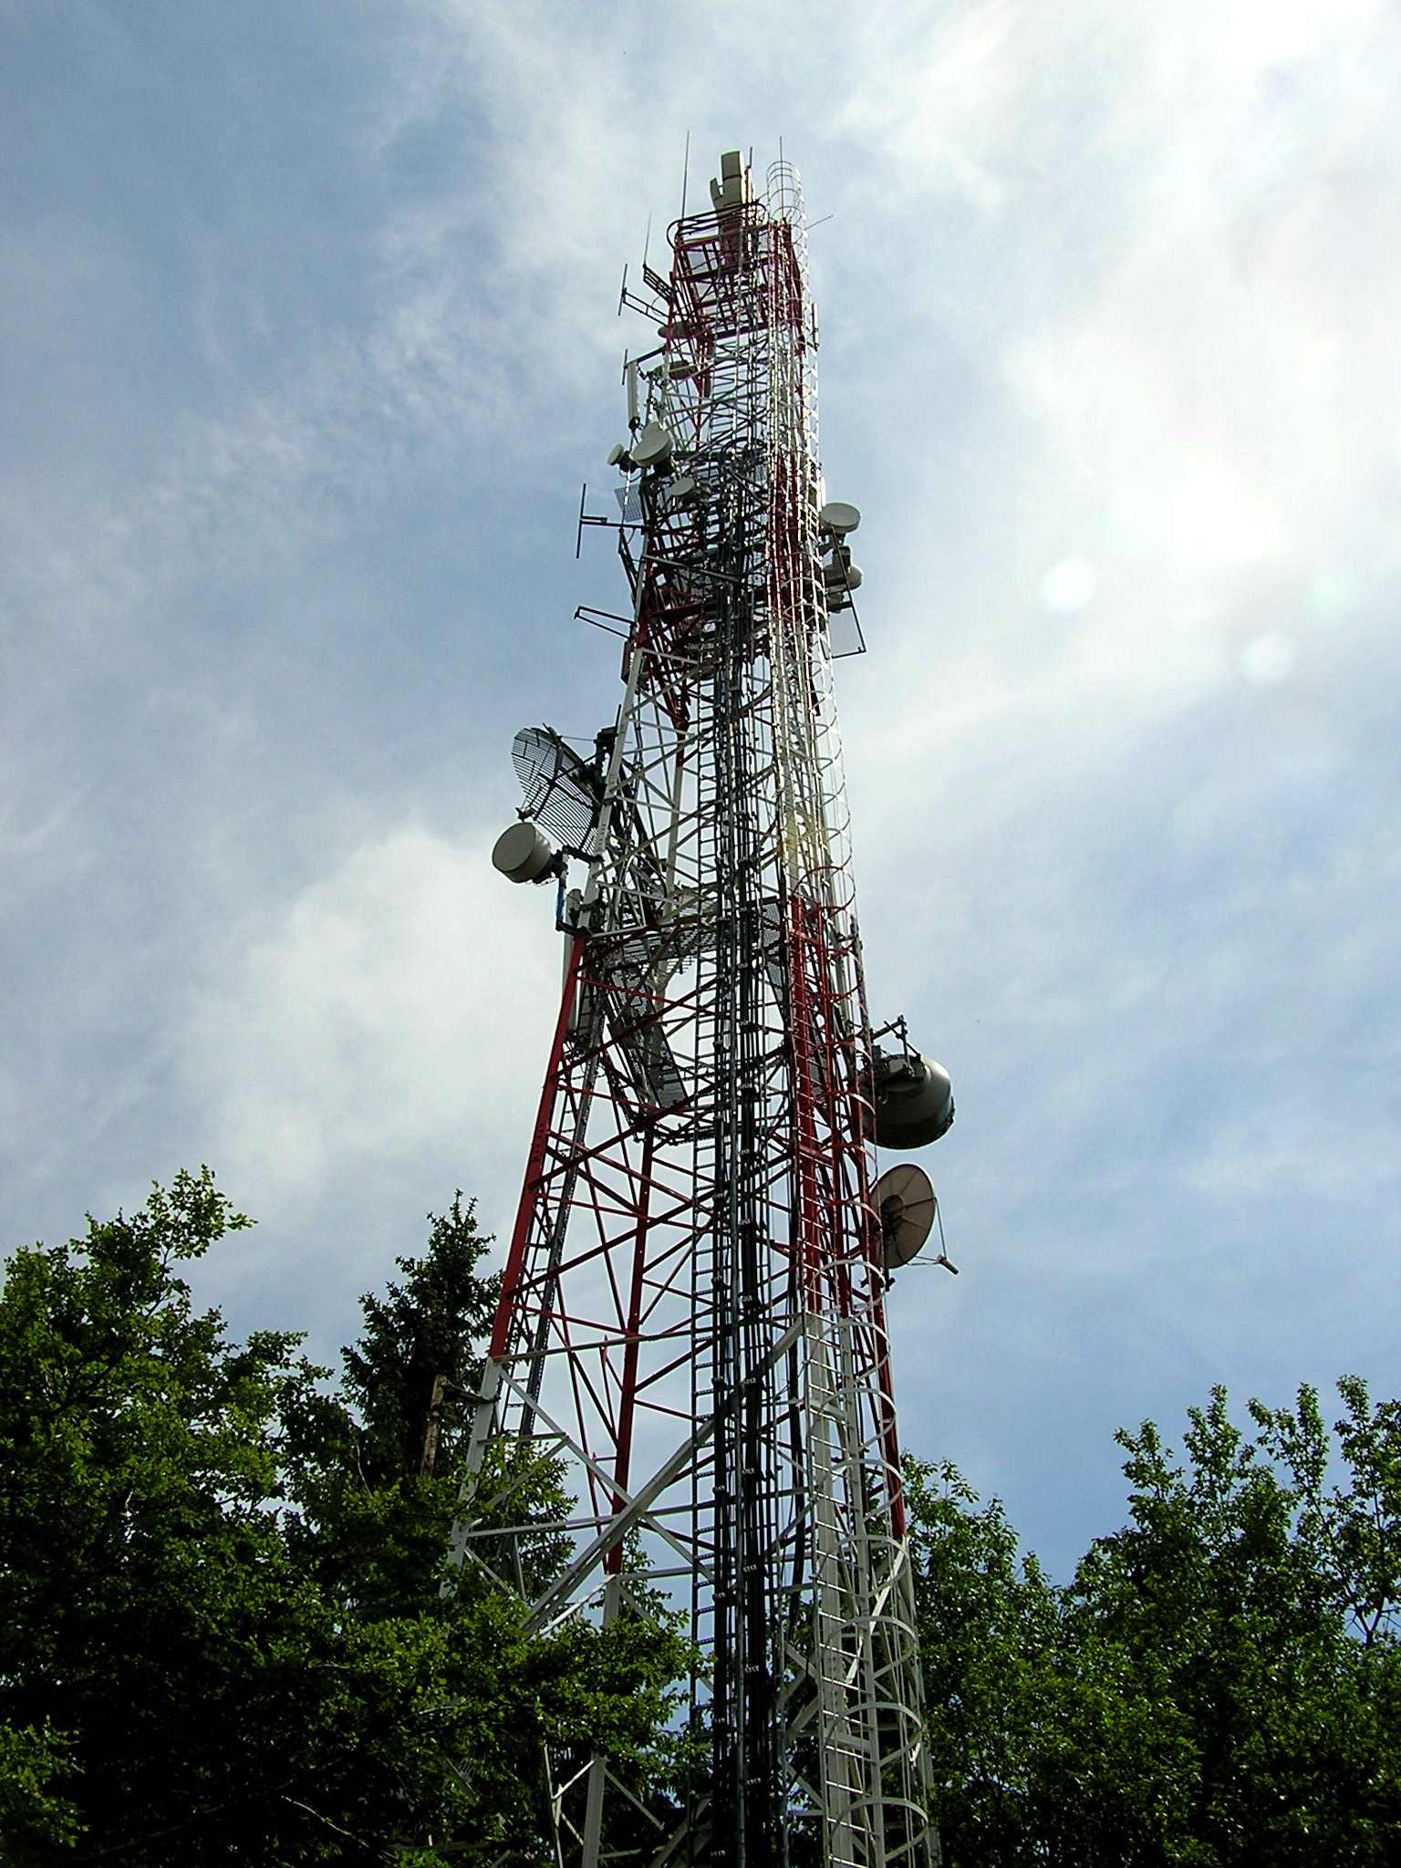
Workshop
Step 1: Objective Risk Assessment of Mobile phone mast
Notes:
How many of you drive here today? How many drove last night? How many drove yesterday?
How many of you broke the speed limit on your journey here?

