Slide 1
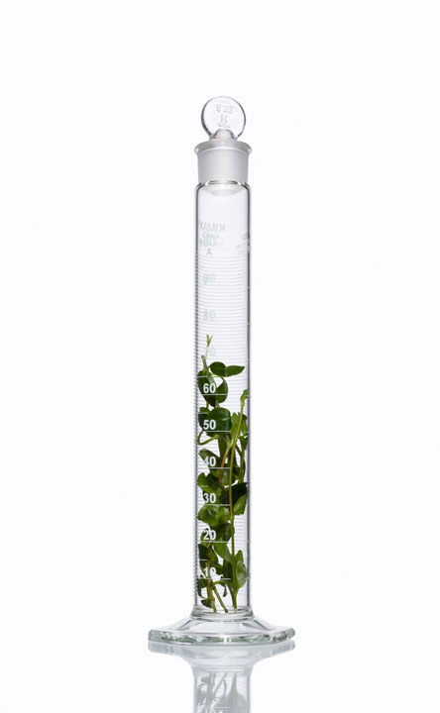
An Example of A Risk Assessment Tool Nancy M. McClellan, M.P.H., CIH, CHMM

Slide 2
Occupational Hygiene: A Simple Picture – A Challenging Process
Risk
Task
Chemical
Control
PPE
Admin
Eng. Control
Evaluation

Slide 3
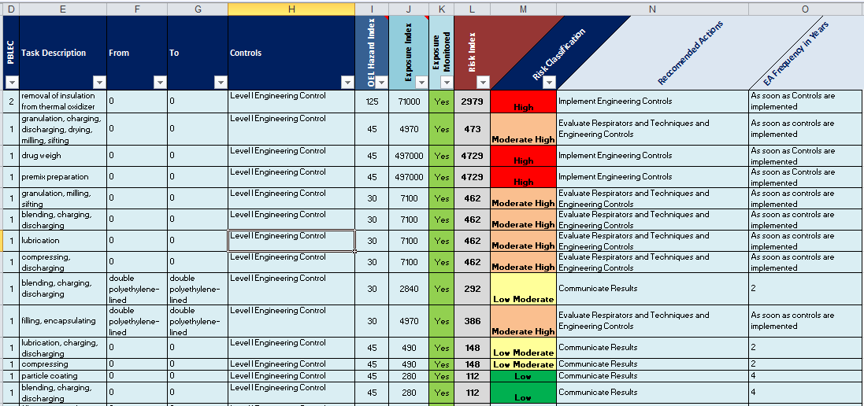
Exposure/Risk Assessment Tool (EA Tool)

Slide 4
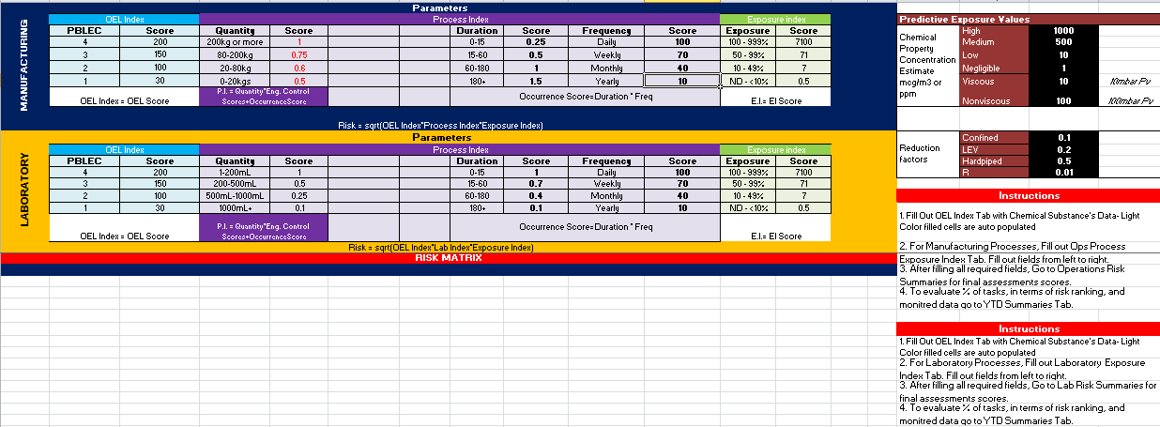
EA Tool Weighting

Slide 5
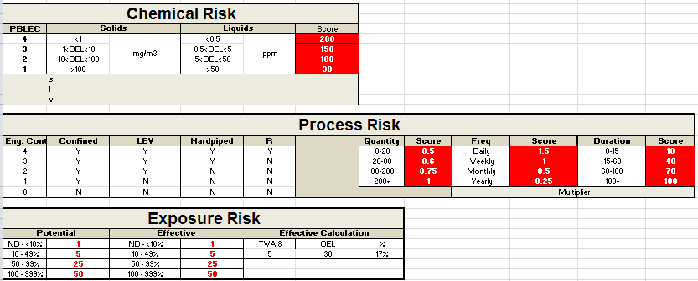
EA Tool Weighting

Slide 6
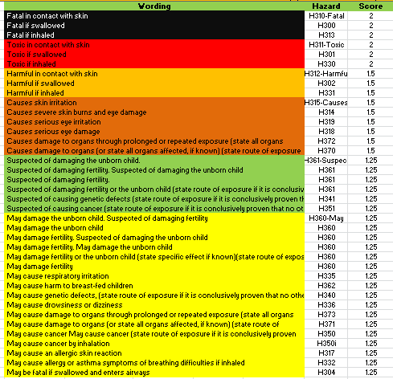
EA Tool Weighting

Slide 7
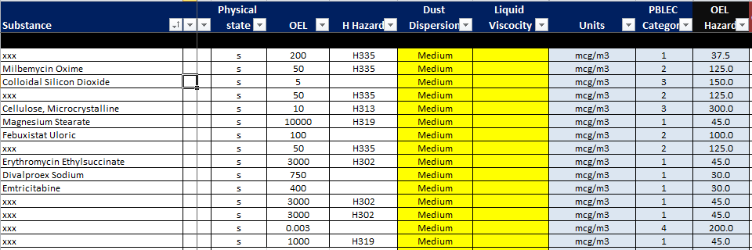
Estimated Exposure Concentration
The dispersion/volatility of substances is based on physical characteristics
OEL hazard index
based on CLP classification and a control band system

Slide 8
Estimated Exposure Concentration
Engineering controls
Estimated exposure concentration
Exposure index

Slide 9
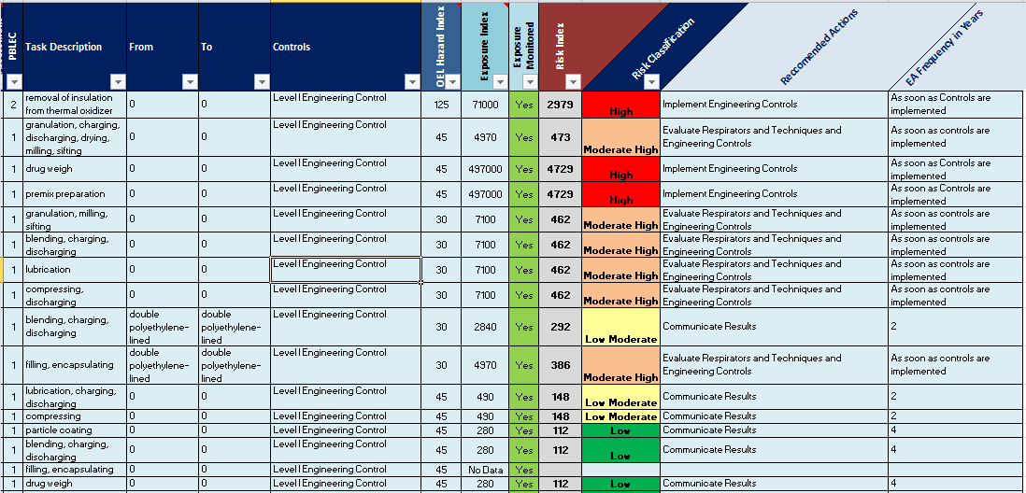
Risk Index and Exposure Monitoring Prioritization
RI = SQR( OEL Hazard Index * Exposure Index )
Monitoring is required for High or Moderate High Risk classification = Outcome of the Risk Assessment

Slide 10
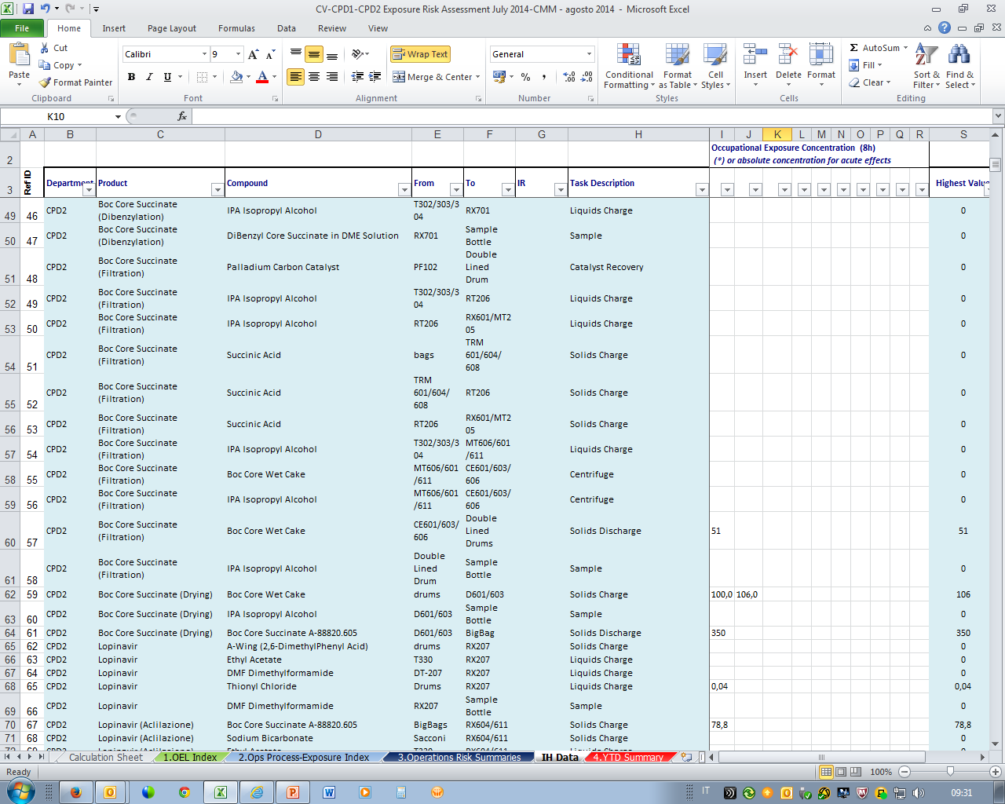
OH Data Collection and Selection
Whenever present, the highest value is used in place of estimated concentration
Opportunity for Direct Insertion of Bayesian Decision Analysis Software

Slide 11
Site Risk Index = Outcome of RA = Key Performance Indice
Used to track the site performances on improvement activities
(LRP: to reduce 50% of SRI on 5 years)

Slide 12
Collaborative Result
Globally Accepted
User Friendly System
Business Focused
Time Effective

Slide 13
To Build or to Buy, That is the Question
To Build:
Garner the support of those who love to develop “Excel Spreadsheets on Steroids”
Takes time to develop and pilot
To Buy:
Purchase and customize (Potential Examples Below)
http://www.palisade.com/risk/?ad=G_@R-8&gclid=CK6Az8uF2MMCFQUPaQodZxEA1g
http://www.medgate.com/software/industrial-hygiene/?pi_campaign_id=11721&gclid=CIL6z9GG2MMCFYNDaQodFm0ArQ

